Slide 1


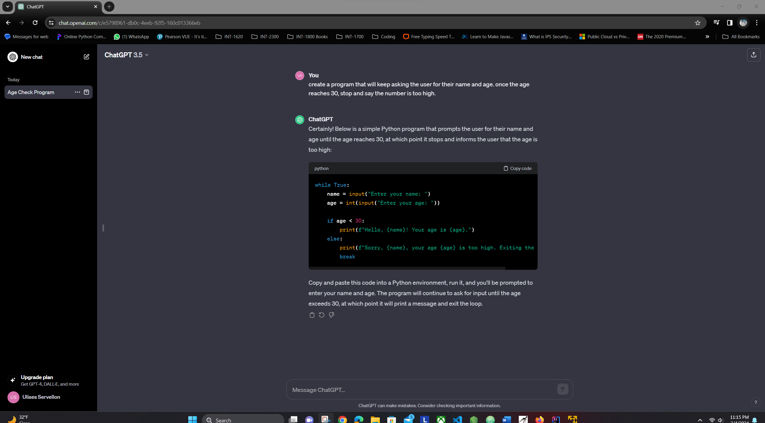
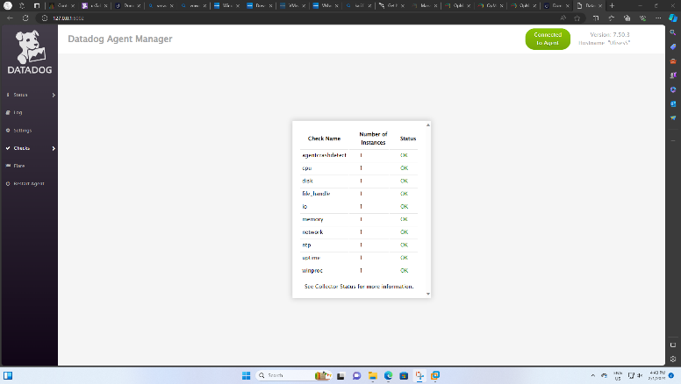
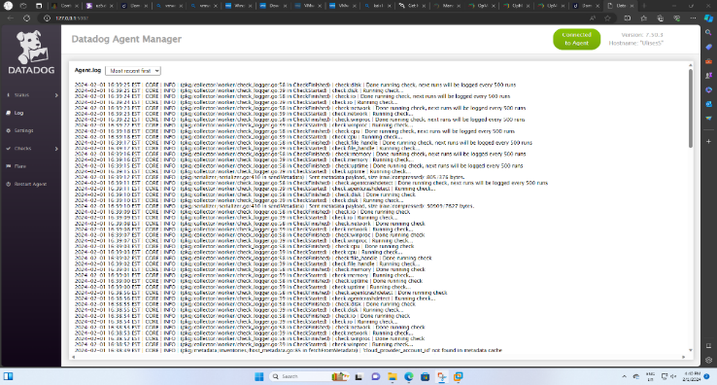
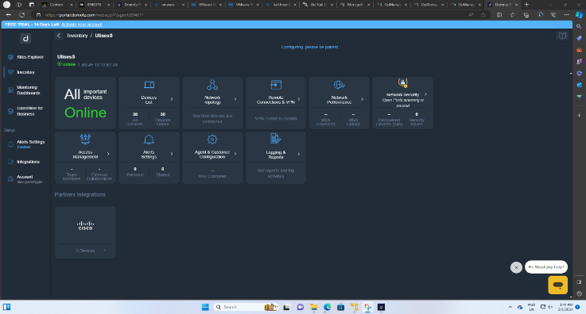
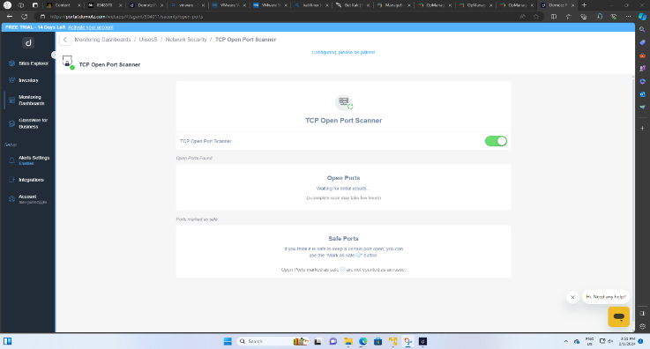
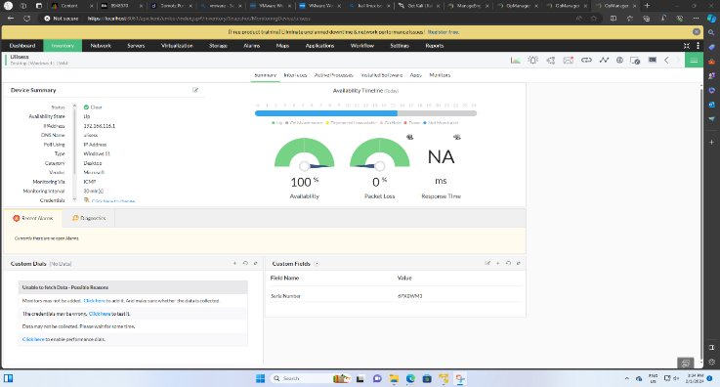
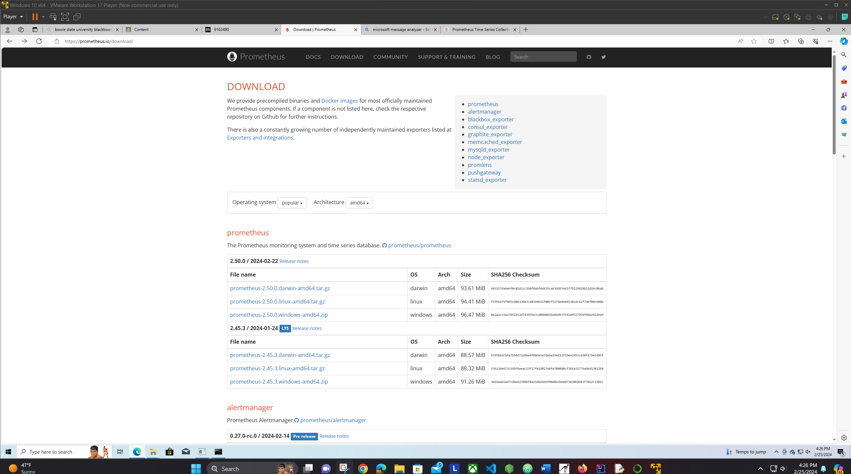
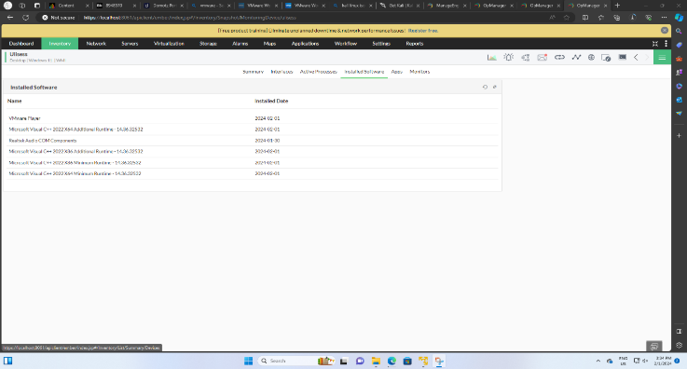
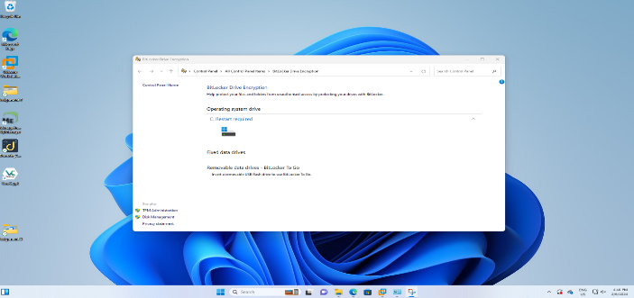
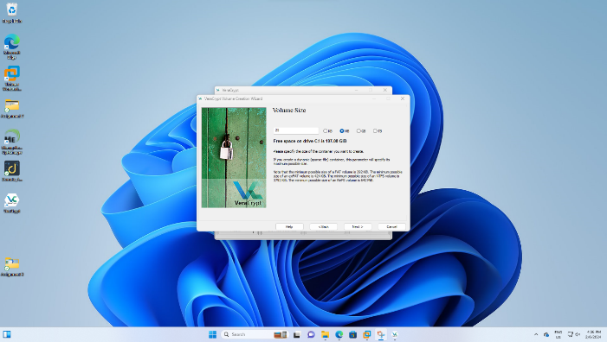
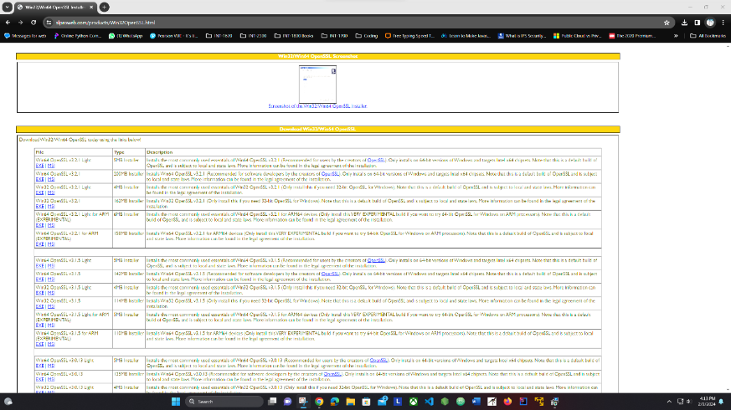
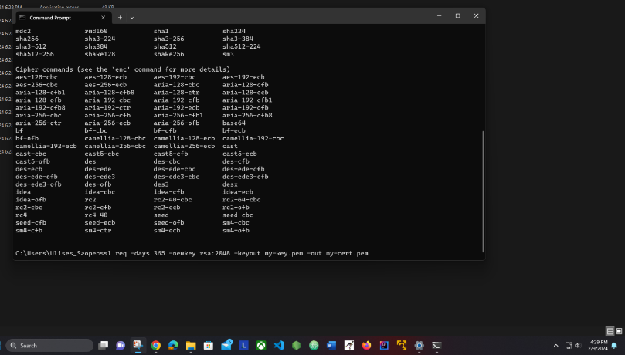
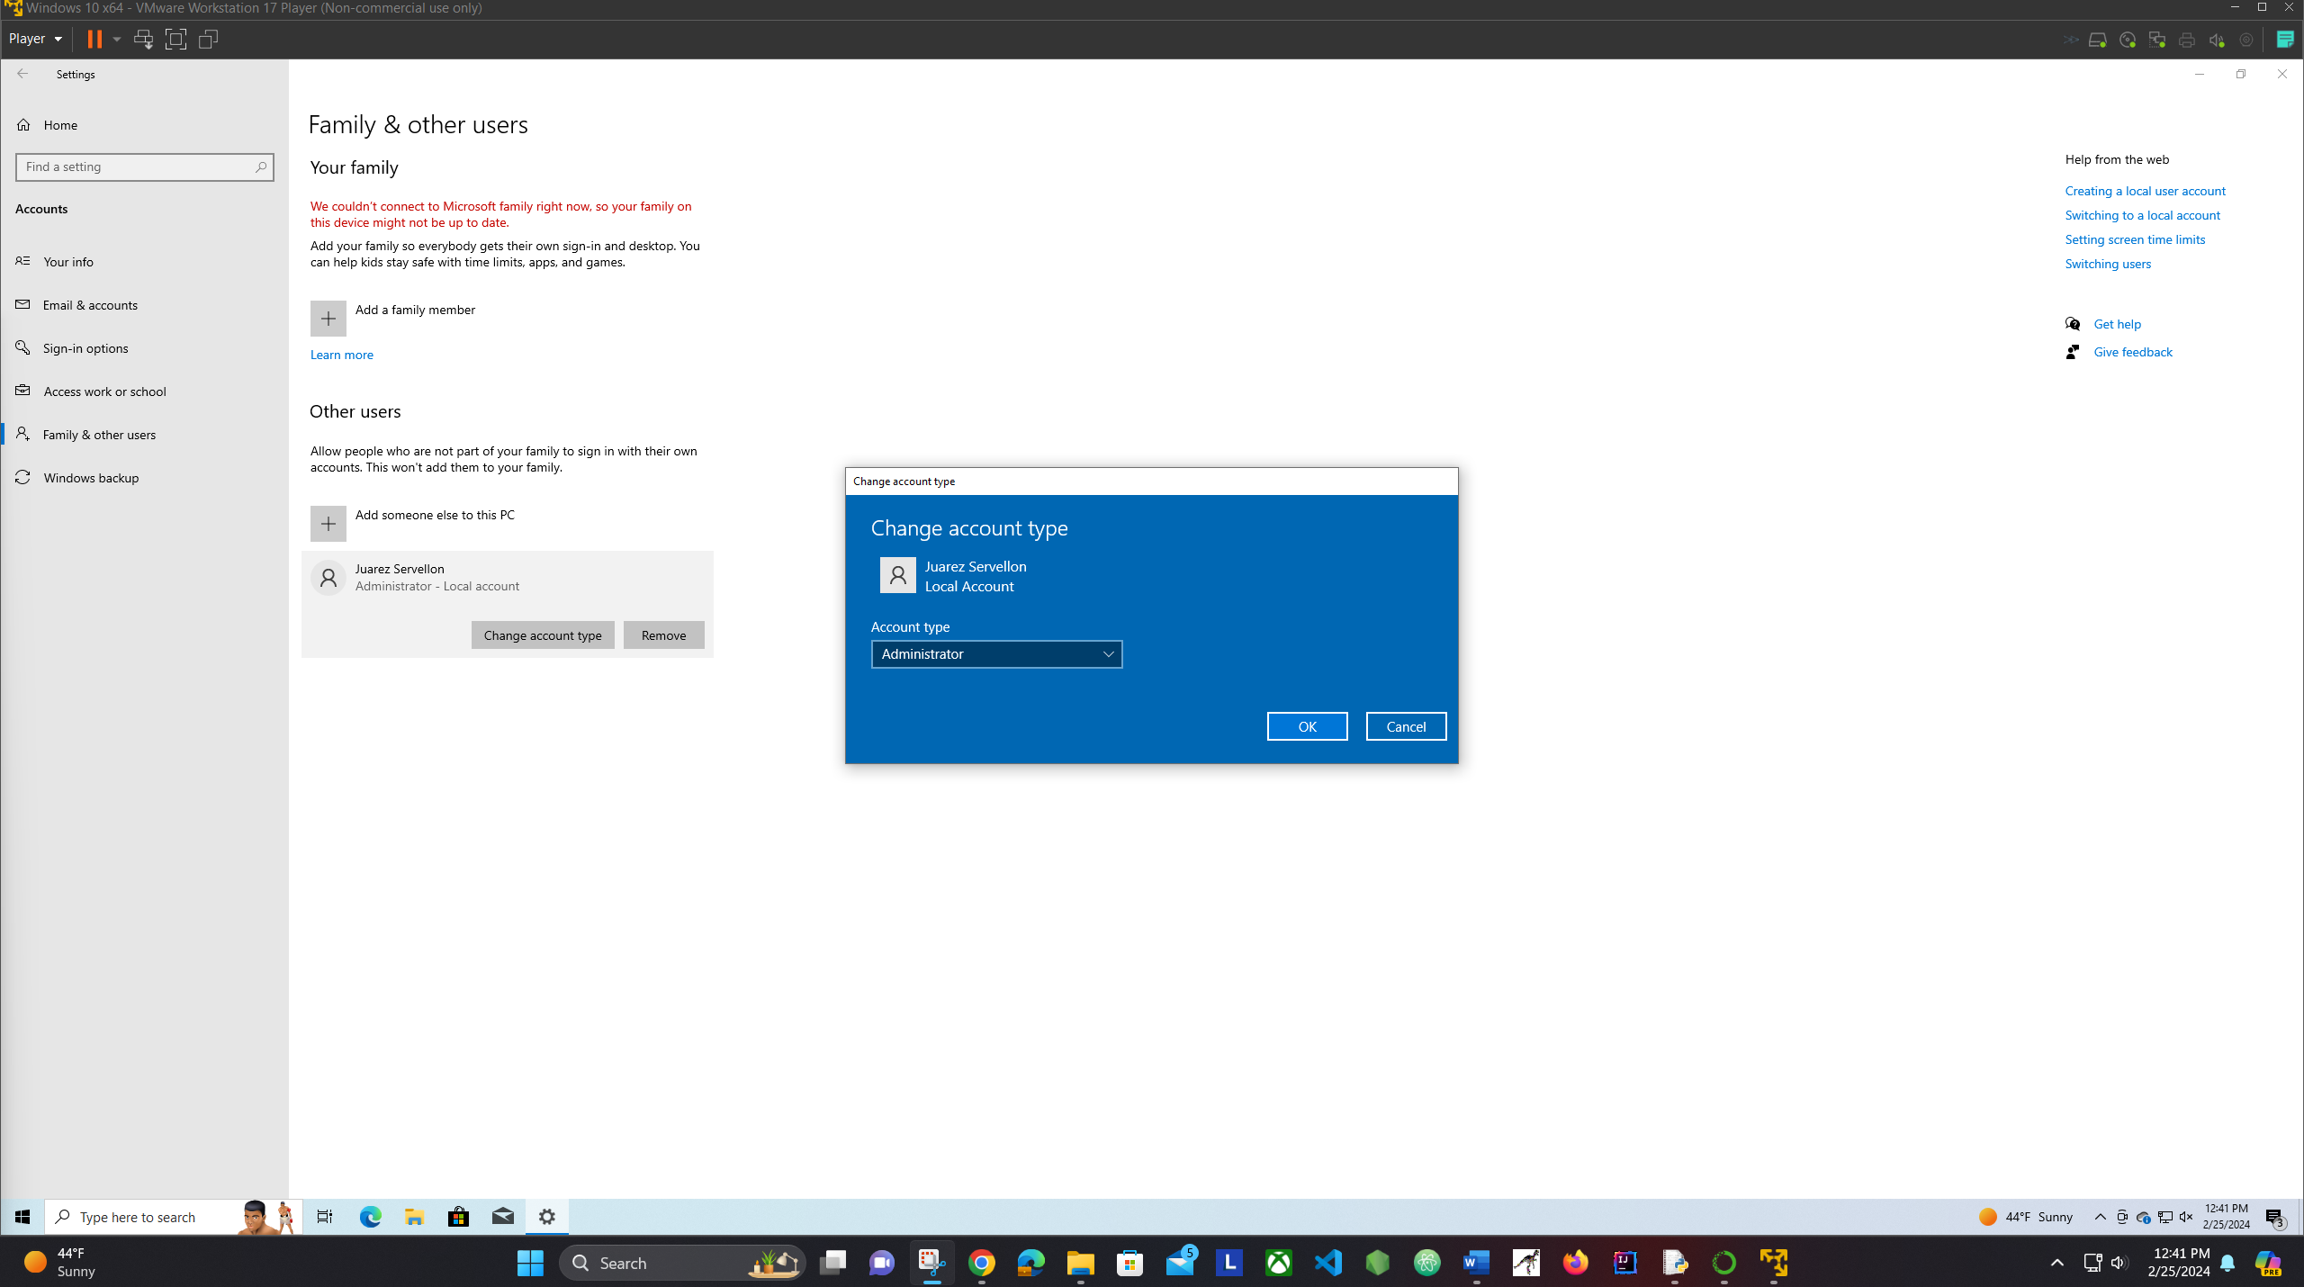
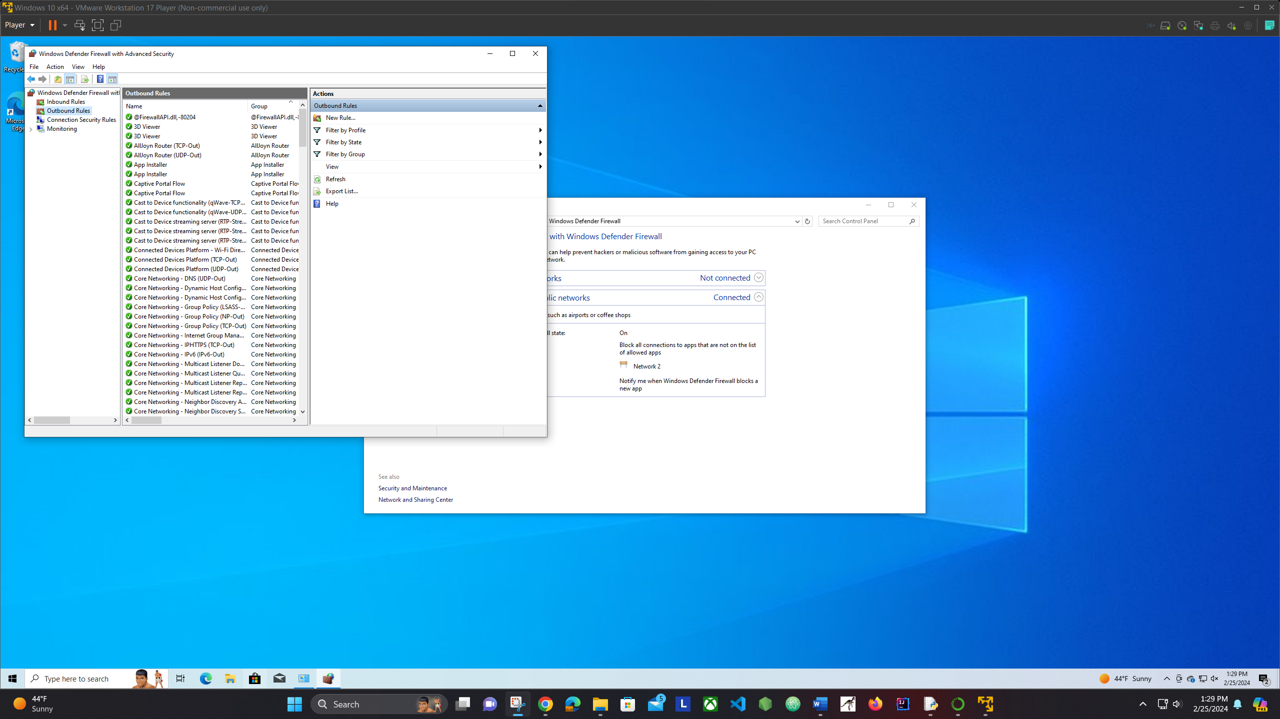
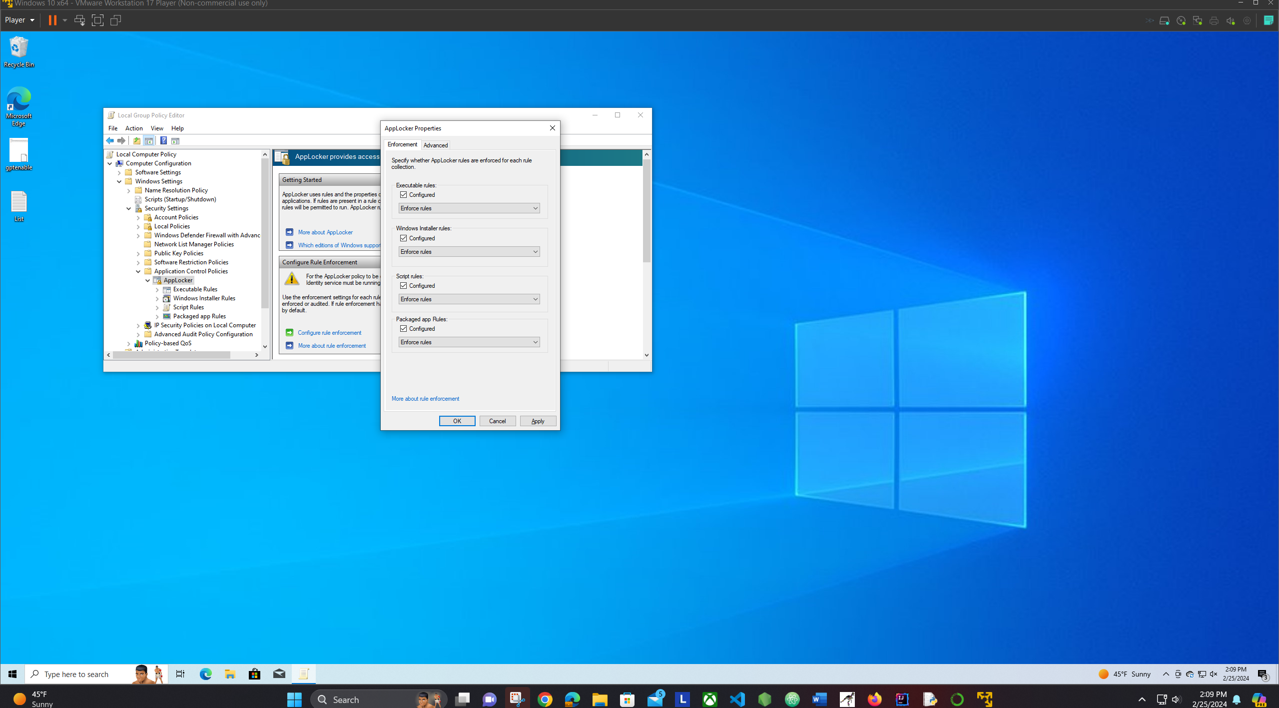
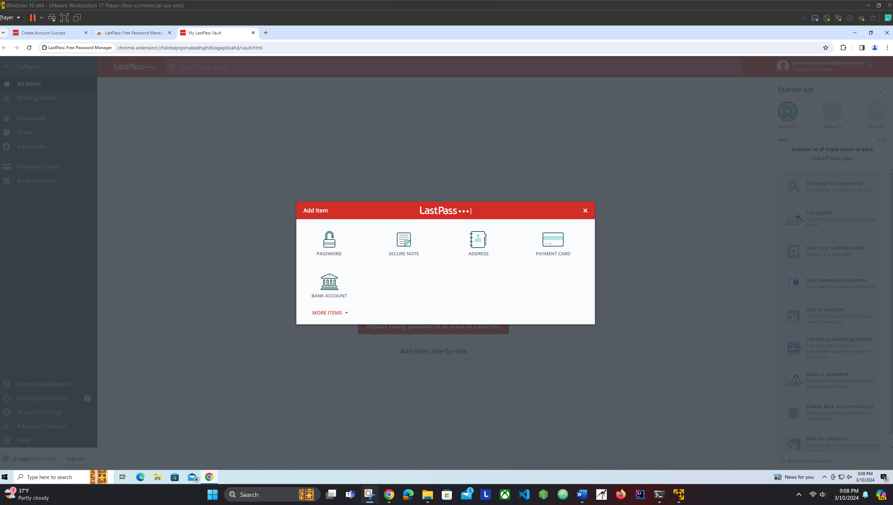
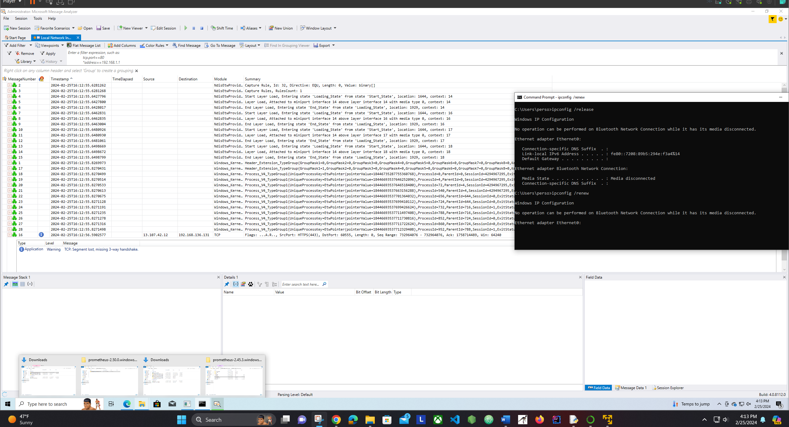
Ulises Alexander Juarez Servellon
Department of Computer Technology
Advisor’s Name (if different from presenter), Department
ABSTRACT
With the increasing number of IoT devices, it is critical to learn how to safeguard your home network. This skill not only benefits you but also everyone connected to your network. Fortunately, there are many open-source software tools and techniques available that are used by security experts to achieve home network security goals. These tools and techniques can also be applied in real-world scenarios to protect companies from malicious threats and actors.
INTRODUCTION
The poster demonstrate many hours of research that involved different types of testing and the used of different techniques that can be used in real life scenarios. The idea of the poster is to provide the audience techniques that they can apply on their jobs and on their personal home computer environments. The poster answers the question, how to protect a network that includes several IoT devices and multiple computers.
METHODS
This document represents multiple online research techniques and many open-source software. These software were used in a virtual machine which allowed me to demonstrate how they work and how they can be used in a real-life network connection.
RESULTS
1- ChatGPT
2- Monitoring Tools
DATADOG
Domotz
OpManager
3- Encrypting Tools
4. Digital Certificates.
6. Whitelisting App, Microsoft Defender
7- Network Packet Sniffer.
CONCLUSION
In conclusion, as I presented the results of the test I conducted on my home computer network, I believe that this is something that you could also do. You just need the appropriate tools and assistance which you can find online. Your willingness to learn could lead you in a path to success, a success that you can use in your IT careers.
DISCUSSION
As you know, everyday the IoT devices keep increasing as their threats. For this reason, the fight continues. Now I wonder, can we install the same tools and use the same techniques in every OS, what are some alternatives, and what can we do to keep up with the upcoming threats?
ACKNOWLEDGEMENTS
My family
Dr. Haydar Teymourlouei
Computer Technology Department

